Slide 1
PERSPECTIVES OF SEXUALLY TRANSMITTED DISEASES IN AFRICA
Elizabeth Anne Bukusi
Chief Research Officer
Kenya Medical Institute
Research Professor , University of Washington

Slide 2
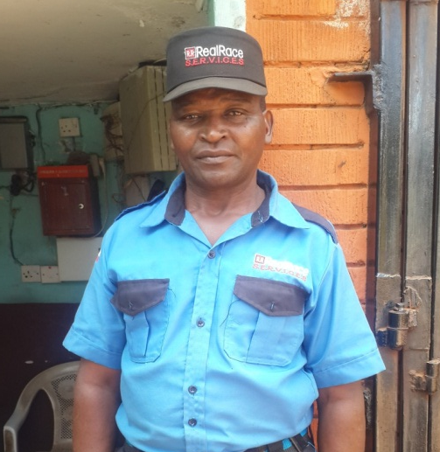
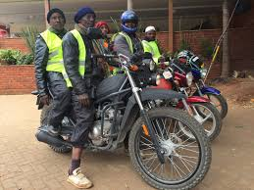

Slide 3
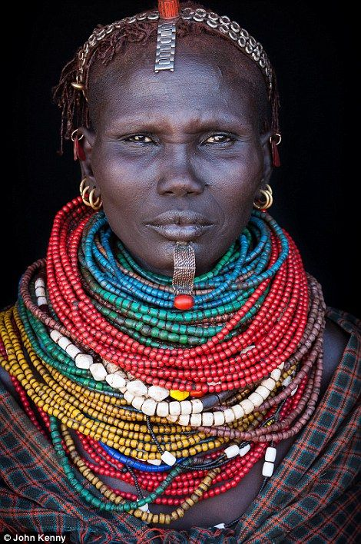

Slide 4
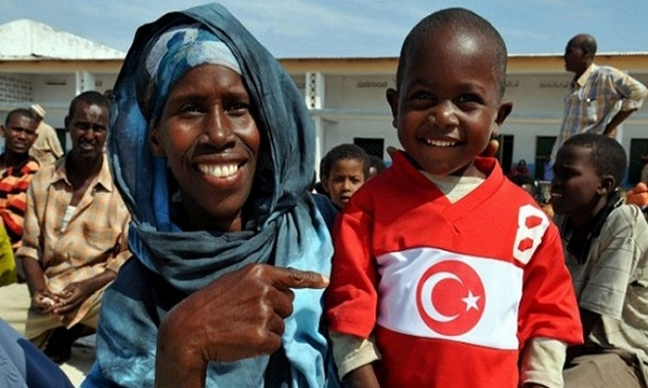

Slide 5
STI’s in Africa
Up to 17% of the total burden of disease.
Syndromic approach
Several efficacious drugs are available
Drug resistance

Slide 6
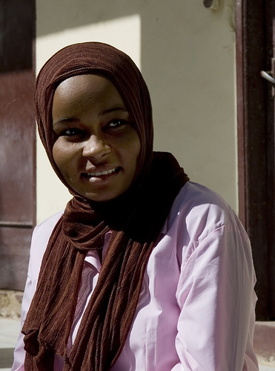
Highest rates of incident STIs have been reported for adolescents and young adults

Slide 7
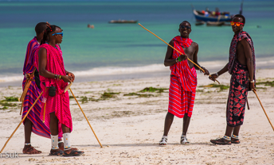

Slide 9
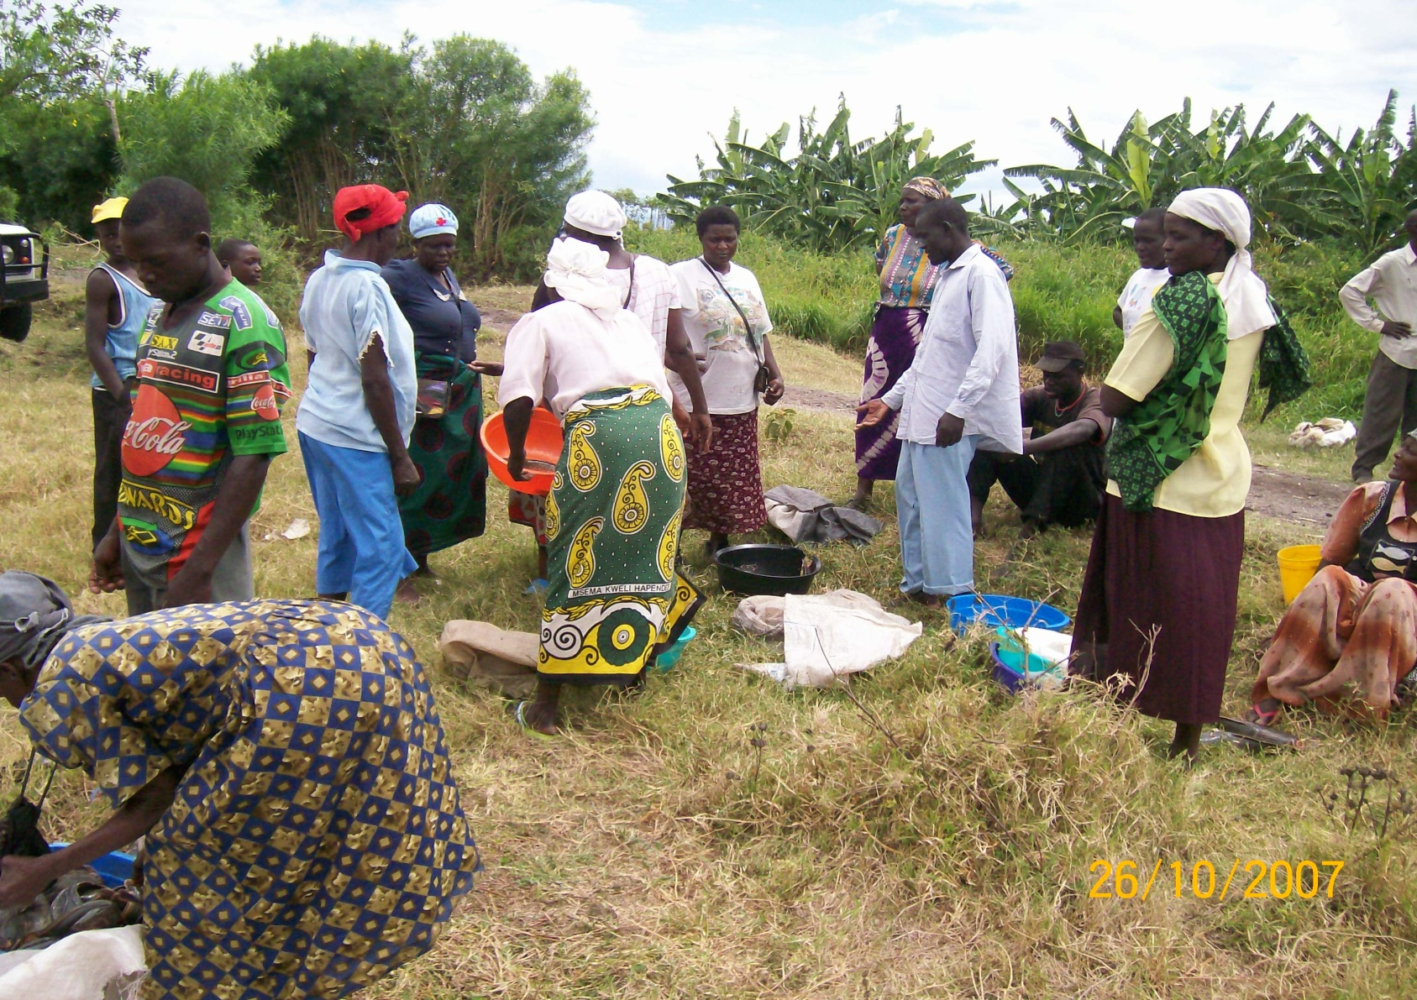
Fishing community - 2008
Notes:
The slide below illustrates the high prevalence of STIs in this population

Slide 10
STI/HIV prevalence

Slide 11
The POWER STUDY – Kisumu Kenya -2018
Age 16-25
Able and willing to provide written informed consent
Recently sexually active (defined as having had vaginal intercourse at least once in the previous three months)
HIV uninfected based on negative HIV rapid tests, on the date of enrollment

Slide 12
STI PREVALENCE

Slide 13
DISRIBUTION BY AGE

Slide 14
MARITAL STATUS

Slide 15
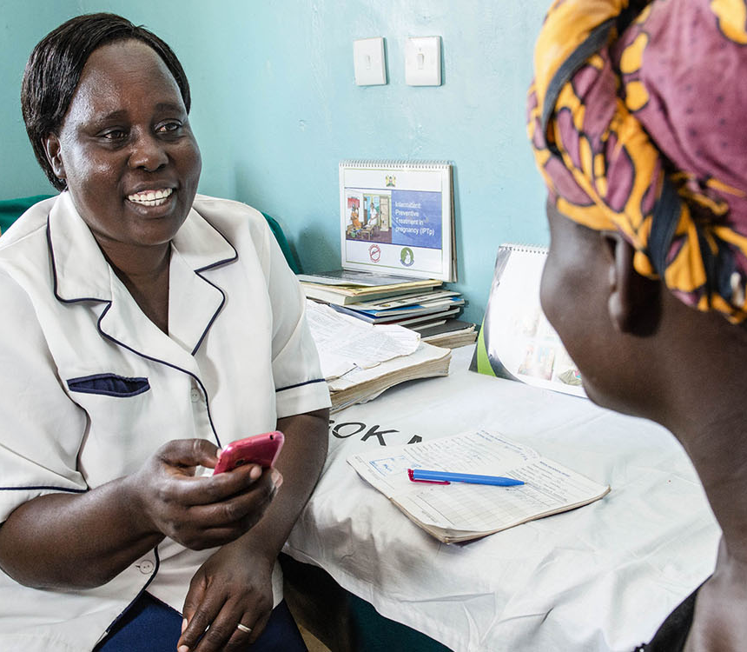
CHALLENGES
Data
Evidence based decision making
Testing for STI’s
Drug resistance testing
Training of health care workers
Health systems

Slide 16
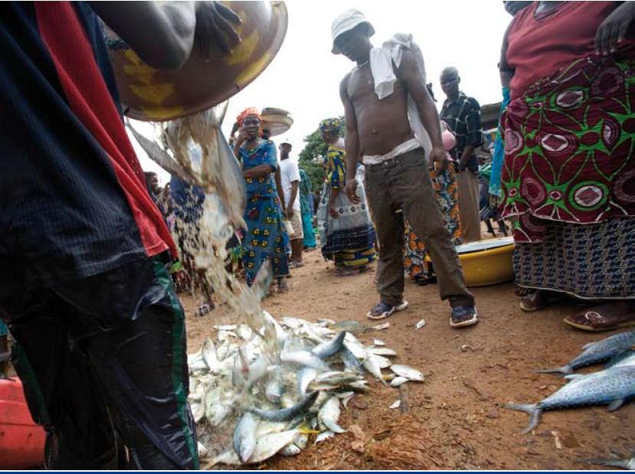

Slide 17
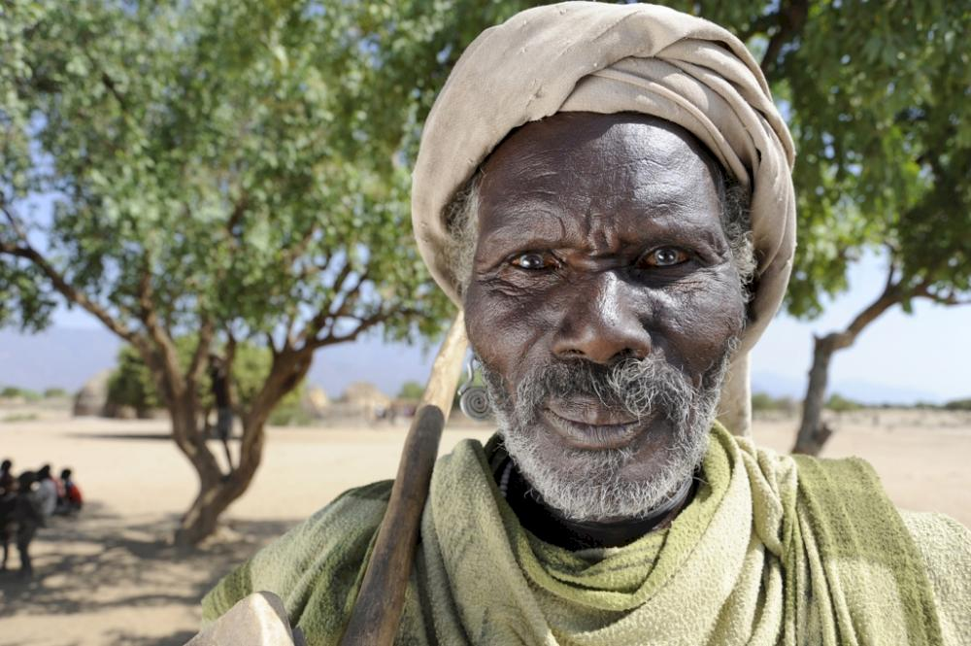

Slide 18
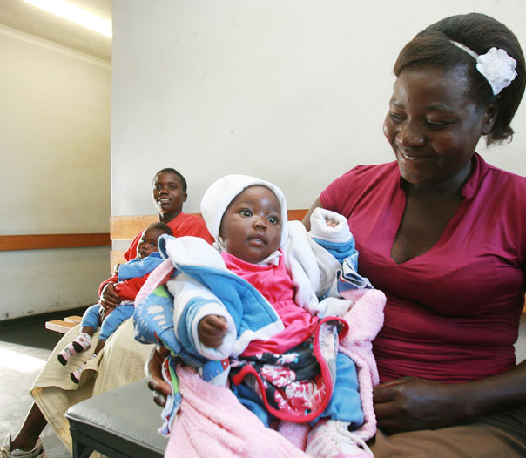

Slide 20
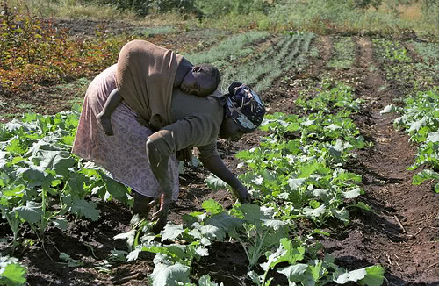

Slide 21
THANK YOU
KEMRI
RCTP
NASCOP - STI / Viral hepatitis task force
Evelyn Ombati
Photos: courtesy –
RCTP File photos
Shaun Bukusi
Google pictures 2018 July

